Slide 1
System Block Diagram

Slide 2
UI
1) UI_in
Get_Path()
Socket_Ref
2) API_in
3) API_start
4) API_fin
Polling()
5) API_out
6) UI_out
Display()

Slide 3
API
Socket_Ref
1) API_start
Polling()
2) API_in
Load_Img()
Load_File(weights)
3) API_out
Model()
4) API_fin

Slide 4
Model
1) Model_in
Conv_Block(conv2d)
Conv_Block(dwsconv2d)
Global_Avg_Pooling()
Conv_Block(convpreds)
2) Model_out
Reshape()

Slide 5
Conv_Block
1) Conv_Blk_in
Get_Weights()
Conv2D()
BatchNorm()
2) Conv_Blk_out
ReLU()

Slide 6
Conv2D
1) Conv2D_in
pad()
Conv2D_Parallel_Reshape()
FCTRL_Master()
Sum()
2) Conv2D_out
Reshape()

Slide 7
FCTRL_Master
1) FCTRL_Mstr_in
Mat_Index()
FCTRL()
2) FCTRL_Mstr_out
Append()

Slide 8
FCTRL
Shared_Memory_Ref
1) FCTRL_in
2) FPGA_in
3) FPGA_start
4) FPGA_fin
Polling()
5) FPGA_out
6) FCTRL_out

Slide 9
Shared_Memory_Ref
FPGA
1) FPGA_start
Polling()
2) FPGA_in
Mat_Mult()
3) FPGA_out
4) FPGA_fin

Slide 10
DE10 Standard | Functional Simulation | Register | BRAM
Accuracy | 99.7 % | 99.6 % | 99.6 %
Total Time (sec) | 309.8 | 1654.3 | 333.5

Slide 11
Matrix | Largest Kernel Matrix | Largest Input Matrix | Largest Output Matrix
Dimensions | 1 x 9 x 16 | 9 x 4096 x 16 | 1 x 4096 x 32
Size (Kbit) | 0.144 | 589.824 | 131.072

Slide 12
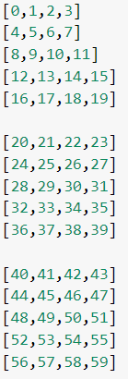
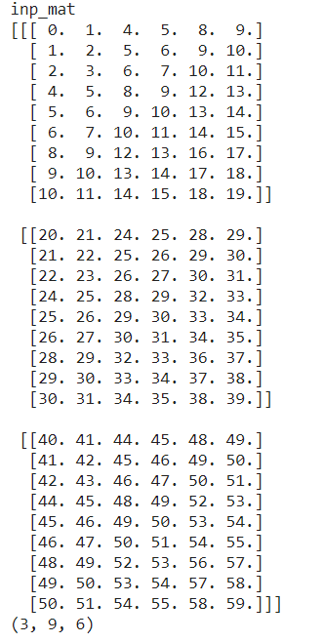
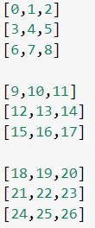
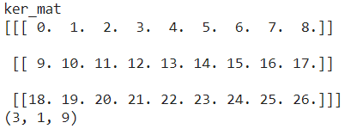
Conv2D_parallel_reshape Example

